Slide 1
As Moths to a Flame: Education Policy Research and the Controversial Issues of Race
By Jeffrey R. Henig
Presenters:
Ifthika Shine Nissar
Jacqueline Marie Mantz

Slide 2
Political Scientist Perspective Quick write
How are institutions affected by race?

Slide 3
Areas of Inquiry
Desegregation and White Flight
Teacher Expectations:
Black Students and White School
Tracking and Second Generation Discrimination
School choice:
Markets as a tool for Equity or Resegregation?
Race-Based vs. Race-Neutral Policies
Race, Civic capacity and Coalition Building for School Reform
Declining Significance of Race?

Slide 4
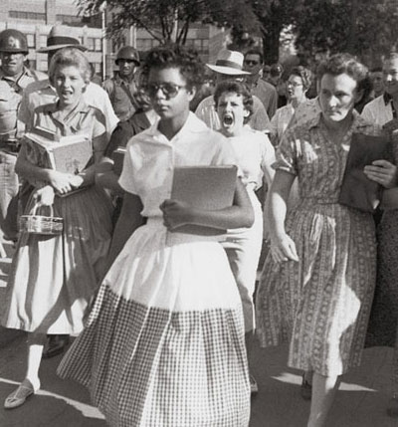
Desegregation and White Flight
Two Streams of Research
Stream 1: Empirical Data:
Measuring racial compositions
of schools
Stream 2: Processes and
Institutions of governance

Slide 5
Measuring Racial Compositions of Schools
Researchers aimed to find a universal answer to the issue of Race
Took place in the 70’s… What was the political landscape in the country?
James Coleman coined the term “white flight”
- school desegregation prompted white teachers to leave these schools
- Black students do better in classrooms with more advanced white students

Slide 6
Lorene Cary on “White Flight”
http://youtu.be/O6SLQ2VsZ68

Slide 7
Processes and Institutions of Governance
How did the local and political leadership respond to the volatile issue of Race?
Robert Crain’s The Politics of School Desegregation (1969): Focused on variations of transitioning to desegregated schools
School Boards were important facilitators to integration
- “Black box” of local politics – approval or disapproval of desegregation S.B. members
Hochschild (1984) challenged idea that populace will uphold equity and justice in terms of race issues
- Majority interest vs. minority rights

Slide 8
Teacher Expectations: Black Students and White School
Early Writings: White teachers low expectations for black students self-fulfilling prophecies
Desegregation of schools resulted in segregation within schools
Pygmalion in the Classroom By Rosenthal and Jacobson (1968) influential in terms of showing teachers expectations influence academic growth
- Intelligence Test
- Black students performed poorly because of the low expectations of white teachers.

Slide 9
Teacher Expectations: Black Students and White School
More Recent Writings : Higher proportions of teachers of color in schools
Race, student success and self-fulfilling prophecies more complicated then previous writings suggest
Jussim and Harbor (2005): “self-fulfilling prophecies do exist but they are generally small, fragile, and fleeting” (p.151)
African American and Hispanic Students make up about 40% of school enrollment in cities such as Atlanta, Detroit and Washington D.C.

Slide 10
Tracking
Early studies focused on harmful affects of tracking:
- Stigmatization
- Locked in less challenging classes
- Less qualified teachers
Tracking could be worse than self-fulfilling prophecies.
Tracking is a second-generational discrimination
Maintaining white classrooms
Jeannie Oakes’s Keeping Track (1985)
- more non-white students found in less academically challenging tracks

Slide 11
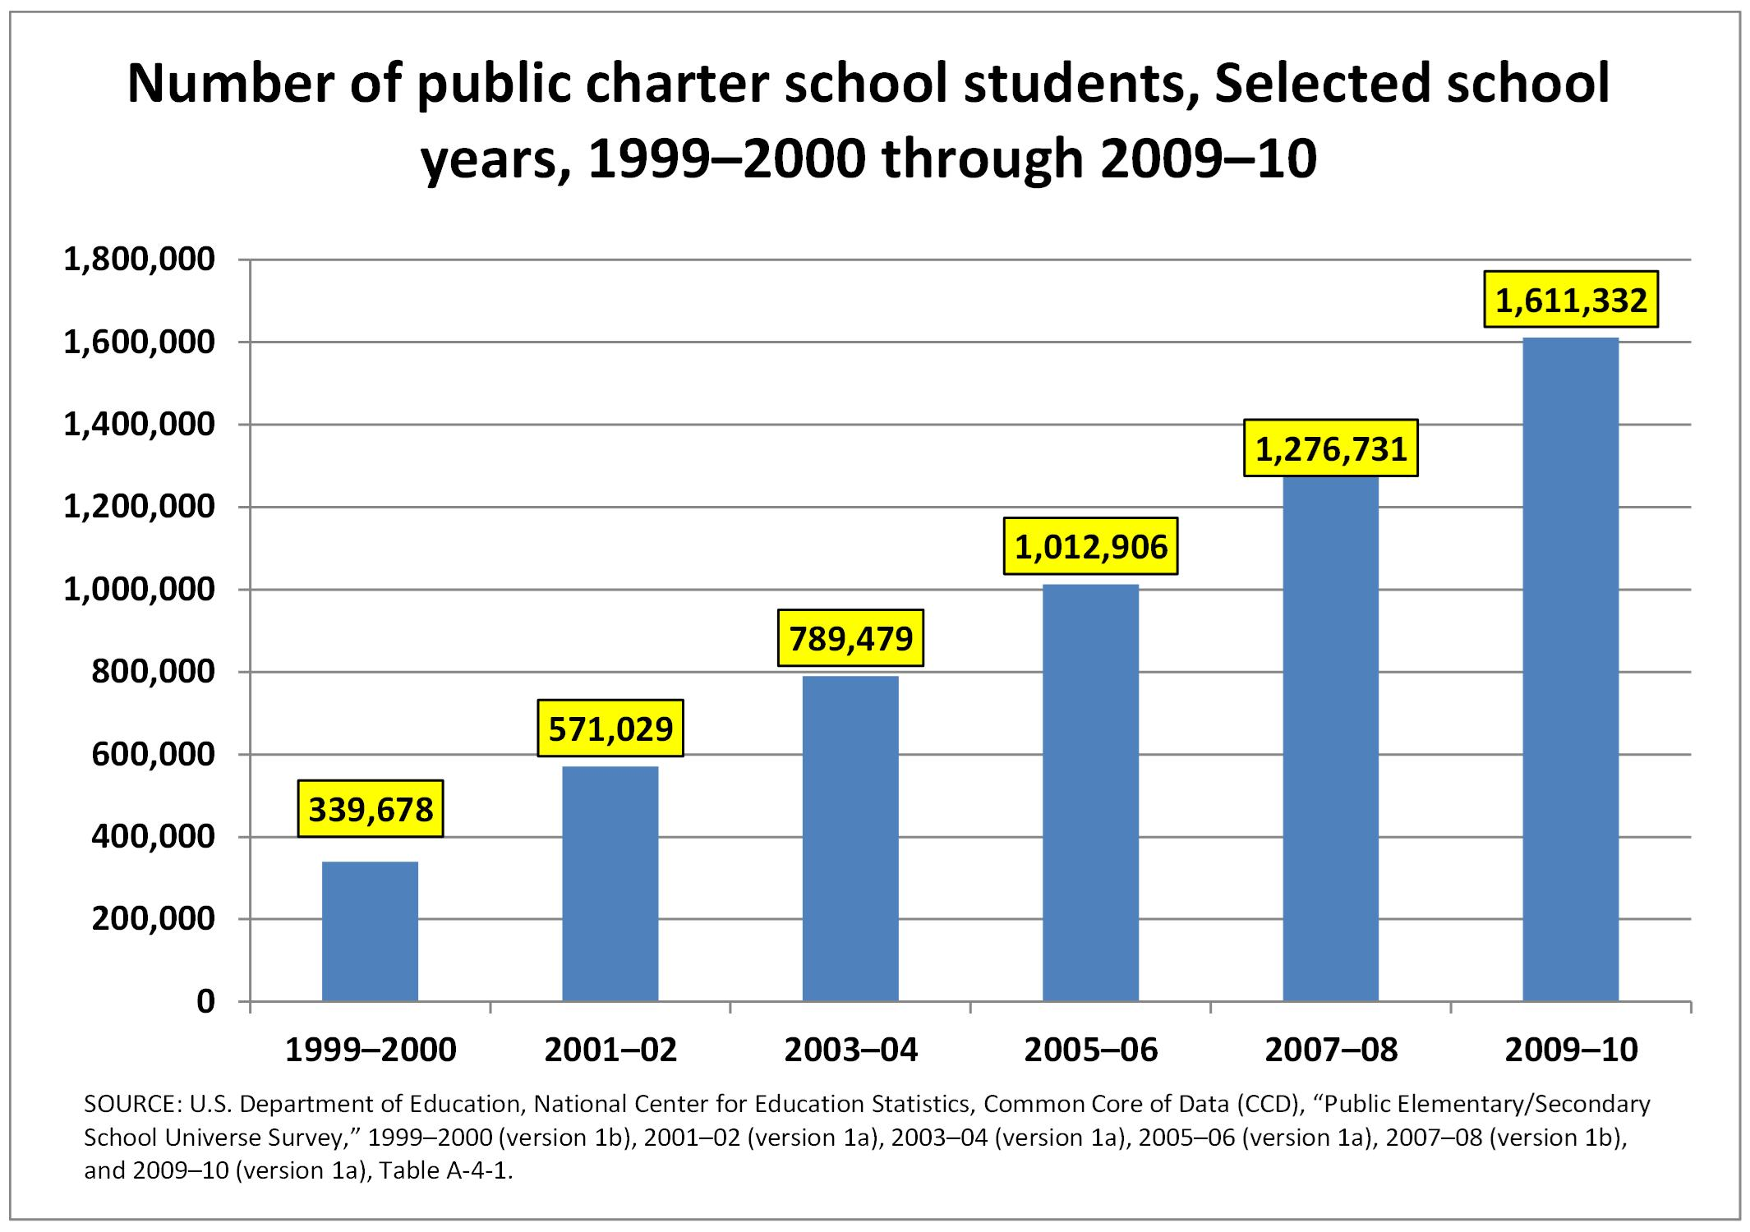
School Choice
Why do you think charter school enrollment has increased so dramatically?

Slide 12
Charter Schools
“Skim the Cream” - Charter schools exclusively targeting white middle class students was unfounded (Department of Education, 2000).
However charter schools may be leading to slightly greater segregation and white flight (Frankenburg and Lee, 2003)
- i.e. 70% Black students in charter schools vs. 34% Black students in Public schools

Slide 13
School Choice Empirical Research
Schneider, Teske, and Marschall (2000) found low-income minority parents stated academic quality is important more often than white parents
White parents more likely to choose schools that have lower percentages of minority children and minority families more likely to choose lower income schools (Henig, 1996)

Slide 14
Is race still what we need to be looking at or are there other factors?
Class
Religion
Culture
Context

Slide 15
Race Based v. Race Neutral Policies
Policies targeted specifically at race face greater challenges than universal policies focusing on other factors politically
Nonracial solutions such as increasing employment, economic growth, and education will go farther in helping all people according to Williams Julius Wilson (1987)
Economic integration rather than racial integration

Slide 16
Race, Civic capacity and Coalition Building for School Reform
Inner city schools face a challenge of cycling reform rather than resistance to reform
“Reforms that go nowhere”
“Flip-Flops”
School Reforms mostly symbolic
Blacks and Latinos do not always share an alliance (Schipps, 2004)
Race a challenge in school reform

Slide 17
Declining Significance of Race?
William Julious Wilson (1978)…
Socioeconomic status greater factor
Race during 1960s and early 1970s
Race Side stepping in the late 1970s
Is research becoming more accurate
OR is less research focused on race issues?

Slide 18
Closure
What do you think of this researcher’s conclusions that race is declining in significance?
Personal opinions
Share Out

Slide 19
Reference
Henig, J.R. As moths to a flame: Educational policy research and the controversial issues of race. The state of education policy research, pp. 131-144.

