Slide 1
Analysis of Preschool Assessment Data Desired Results Development Profile Preschool © DRDP – PS (2010)
Ifthika “Shine” Nissar, M.A
EDUC 738 – Assessment and Evaluation
August 30, 2014

Slide 2
The Desired Results Developmental Profile © – Preschool (DRDP-PS)(2010)
DRDP is an assessment instrument developed by the California Department of Education, Child Development Division (CDE/CDD) to assess the growth and development of preschool children (3-5 years).
The DRDP-PS© is designed for teachers to observe, document, and reflect on the learning, development, and progress of all children in an early care and education program.
http://www.desiredresults.us/form_drdp.htm
http://www.cde.ca.gov/sp/cd/ci/documents/drdp2010preschooleng.pdf.

Slide 3
The DRDP PS (2010) has 43 Measures in 7 Domains:
Self and Social Development (SSD).
Language and Literacy Development (LLD),
English Language Development (ELD),
Cognitive Development (COG),
Mathematical Development (MATH),
Motor and Perceptual Development (MPD),
Health and Safety (HLTH)

Slide 4
Measures of the Self and Social Development (SSD) Domain and Developmental Levels
SSD1: Identity of self
SSD2: Recognition of own skills and accomplishments
SSD3: Expressions of empathy
SSD4: Impulse control
SSD5: Taking turns
SSD6: Awareness of diversity in self and others
SSD7: Relationships with adults
SSD8: Cooperative play with peers
SSD9: Socio-dramatic play
SSD10: Friendships with peers
SSD11: Conflict negotiation
SSD12: Shared use of space and materials
Development Levels
Exploring - 0, Developing – 1, Building – 2, Integrating - 3

Slide 5
Classical Test Theory: Interpretation of Results
Mean (26), Median (27), and Mode (30) of person scores;
Range – 15 (34-19=15)
standard deviation – 4.1
Item difficulty – 11 Conflict Resolution/H and Relationship/E
item discrimination - .17 and .38
Reliability coefficient – 0.80
Standard Error of Measurement (SEM) – 1.8
What does all this mean?
Let’s Review– Handout and excel document…

Slide 6
Test Reliability and Validity
https://www.youtube.com/watch?v=QY06XOanLzA

Slide 7
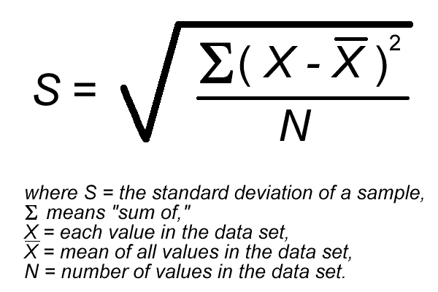
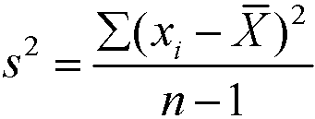
Don’t Let Formula’s scare you! Get excel to do the job
Formula to calculate the Standard Deviation
Formula to calculate the Variance. Variance is needed to compute the S.D

Slide 8
Modern Test Theory: Interpretation of Results
Variable Table
The figure represents the student abilities and item calibration on a common Logit Scale.
On the Left is the student ability and on the Right is the Item calibration stated as measures.
The spread of the distribution of students were wider than the spread of the measure distribution.
Distribution of the variables: students are distributed between -3.05 to 5.29 Logits and Measures were distributed between -1.69 to 2.11(Measure 1 and Measure 12) Logits.

Slide 9
Variable Table
STUDENTS - MAP - MEASURESS
<more>|<rare>
6 T+
|
|
|
83 |
5 +
|
23 53 |
|
|
4 +
03 12 S|
|
03 03 33 53 |
|
3 43 +
|
73 |
|
23 32 43 63 | Item 12
2 +
|T
62 82 93 |
M|
|
1 22 +S
|
| Item 11
| Item 10 Item 7 Item 8 Item 9
|
0 42 72 72 +M
| Item 6
| Item 5
| Item 4
| Item 2 Item 3
-1 12 S+S
|
|
12 62 92 92 | Item 1
|T
-2 +
82 |
|
32 |
|
-3 52 +
<less>|<frequ>
The figure represents the student abilities and item calibration on a common Logit Scale.
On the Left is the student ability and on the Right is the Item calibration stated as measures.
The spread of the distribution of students were wider than the spread of the measure distribution.
Distribution of the variables: students are distributed between -3.05 to 5.29 Logits and Measures were distributed between -1.69 to 2.11(Measure 1 and Measure 12) Logits.

Slide 10
Summary Statistics (Summary of Measured Students & Summary of Measured Measures/Items)
Mean -Mean of the student in Self and Social Development was 1.36 Logits higher than the mean calibration of item difficulties (0 Logits), I would recommend to include more difficult items to the assessment. There was a far greater distance between the mean of the students and the mean of the Measure. This is too wide. Because the mean of the student from the item is > 1 this can yield to an inaccurate measurement. Items that are aligned to abilities are measured more accurately. As Measure 6, 5, 4, 3 and 2 are situated closer to the mean of the Measures there could be no difference in skill mastery.
S.D : S.D was 2.37 Logits and for measures was .92 Logits. S.D for students were about 2 ½ times higher than for students item calibration.
Mean of the Raw score: Mean of the students was 26.4 and Mean of the Measures was 66.1
Standard Deviation of the Raw Score: S.D of students was 4.0 and S.D for the Measures was 4.4
RMSE (Root Mean Square Error): RSME for students was .81 and .49 for items
Student Reliability was .88 and Measure Reliability was .72
STUDENT RAW SCORE RELIABILITY = .87. This compared with the Rasch Model are about the same .80. This reflects that the data is very reliable to the sample of 12 measures of the DRDP.

Slide 11
Student (Person) Fit Order Table –
This table gives us the INTFIT and OUTFIT information and tells how well the student’s responses fit the model.
Looking at the outfit and using a criteria of 2.0 for standardized Z (ZSTD), there are 6 students who do not fit the model.
Their patterns of responses reflect that they don’t adhere to the Rasch model.
The pattern of Responses has too many inconsistencies. These students’ response patterns underfits the Rasch Model. I will delete students 16, 21, 10, 17, 6 and 8 and run the data again

Slide 12
Scalogram – Table 6.4
TABLE 6.4 Preschool DRDP Assessment Data Scalogram
INPUT: 30 STUDENTS 12 MEASURESS MEASURED: 30 STUDENTS 12 MEASURESS 3 CATS
--------------------------------------------------------------------------------
MOST MISFITTING RESPONSE STRINGS
STUDENT OUTMNSQ |MEASURES
| 1 11
|132450712
high---------
16 82 2.61 A|.......31
21 42 2.34 B|.3..1....
10 43 1.91 C|......1..
17 62 1.74 D|......33.
6 33 1.68 E|........3
8 03 1.68 F|........3
4 12 1.67 G|2.......3
27 92 1.13 I|.1.......
13 32 1.02 J|......3..
18 93 1.06 K|.......3.
15 63 .96 M|.....3...
3 53 .93 N|...2.....
25 62 .87 o|....1....
23 12 .62 n|.......1.
19 22 .52 k|..3......
|-----low-
|132451711
| 0 12
The Scalogram gives us the most misfitting response strings and what the misfitting string was. The data reveals that:
Student number 16 did not fit the responses for measures (items) 11 (SSD11: Conflict negotiation), and 12 (SSD12: Shared use of space and materials) 16 student’s responses did not fit.

Slide 13
https://www.youtube.com/watch?v=fnF2hrLZHoA
Test Reliability and Validity

Slide 14
Professional Judgments and Conclusions
According to Messik (1995) validity, reliability and comparability are not just measurements of principles. They also have social values.
I questioned the scores many times as it did not reflect what the construct was measuring.
The data analysis reflected this assessment tool to have a high reliability (0.80).
Just because a test is reliable it is not valid. I now understand that reliability and validly are two important measures which have to be paid close attention.
A test result could benefit or harm students. Tests should be administered by trained professionals.
Formative assessments are very important to help students along and get them prepared for summative assessments.
I have truly enjoyed this course as I learned a lot and pushed myself beyond my comfort zone.

Slide 15
Thank you!

